Slide 1



AgroGuard: Plant Disease Prediction System
PROJECT MEMBERS
Manivel Karthik K 23ITR092
Mounith D 23ITR103
Pradeep B 23ITR116
Pranesh R 23ITR118 RI
PROJECT GUIDE
Dr.R.ShanthaKumari Associate Professor

Slide 2

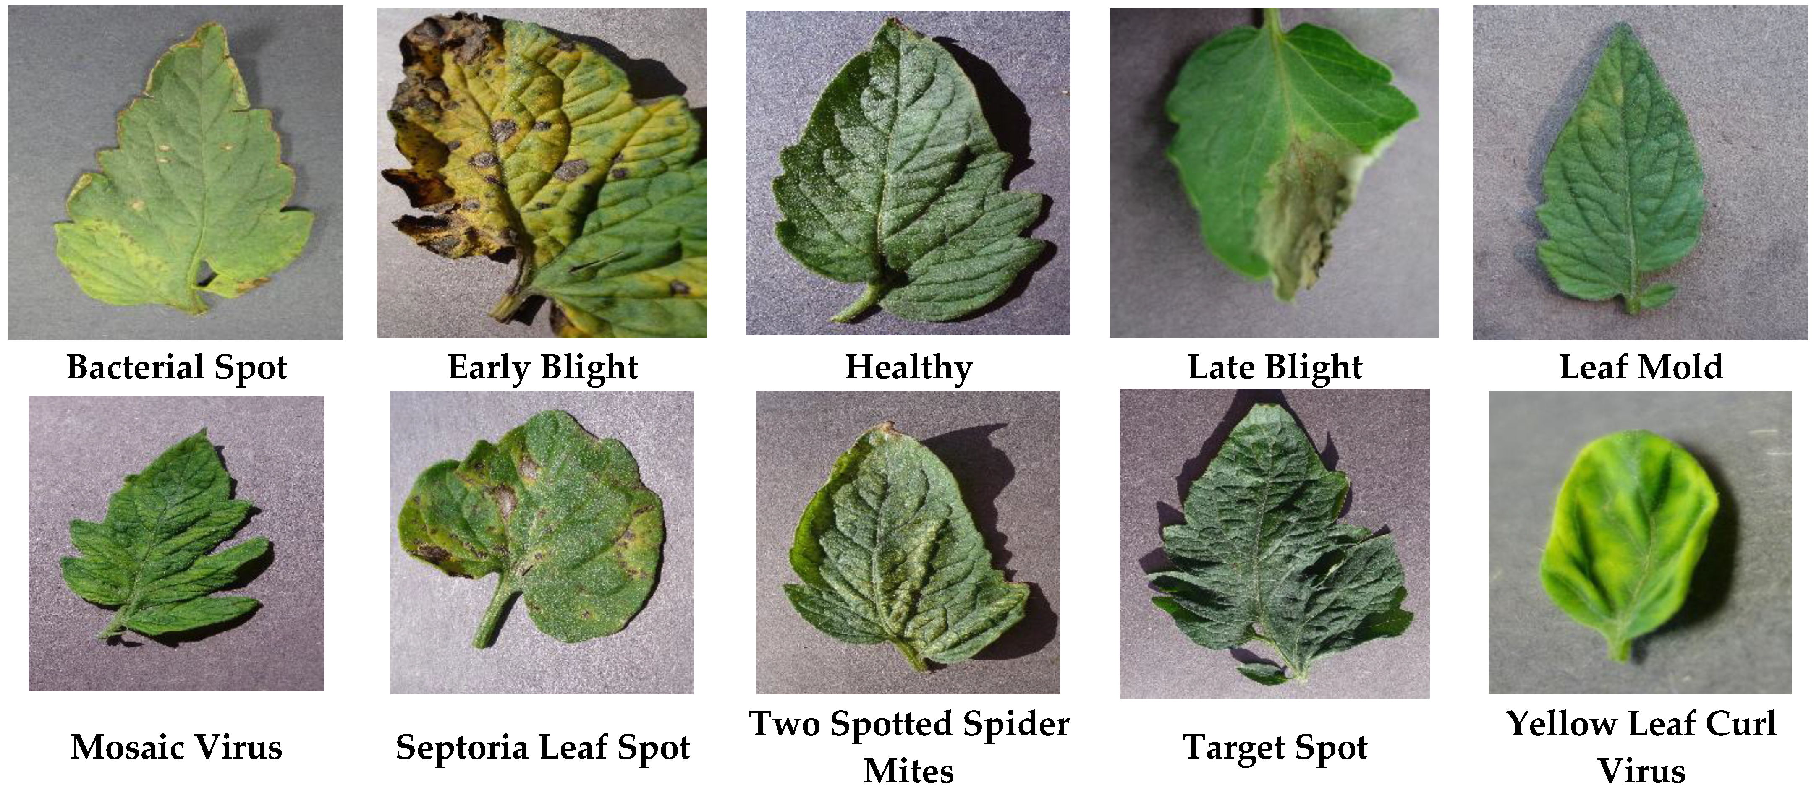
Farmers often face difficulty in identifying plant diseases accurately and on time.
Traditional methods is slow and need more personal experience or expert help, which may be costly, and sometimes inaccurate.
If the diagnosis is wrong or delays in treatment can lead to poor crop quality, reduced yield, or even total crop failure.

Slide 3
Objectives
To develop a smart and user-friendly system that helps identify plant diseases using leaf images.
To implement deep learning techniques, specifically Convolutional Neural Networks (CNN), for accurate disease detection.
To make the solution easily accessible through mobile phones or computers for use in rural and remote areas.
To reduce manual diagnosis or expert intervention, saving time and cost.
To enhance crop yield and quality by promoting timely and effective disease treatment.
3

Slide 4
Existing System
Apps like Plantix and Leaf Doctor often misclassify diseases under poor lighting or unclear images.
Tools like Agrios and Crop Doctor may not support regional crops or less common diseases.

Slide 5
Implementation Details
FLOWCHART
Start
↓
Upload Image
↓
Image Preprocessing
↓
[Disease Prediction (CNN Model)]
↓
Result
↓
Disease & Suggested Treatment
↓
[End]
Input Image
Database Image
Pre Processing
Training Images
Normal
Classification
Feature Extraction
Defect Region Classified
Abnormal

Slide 6
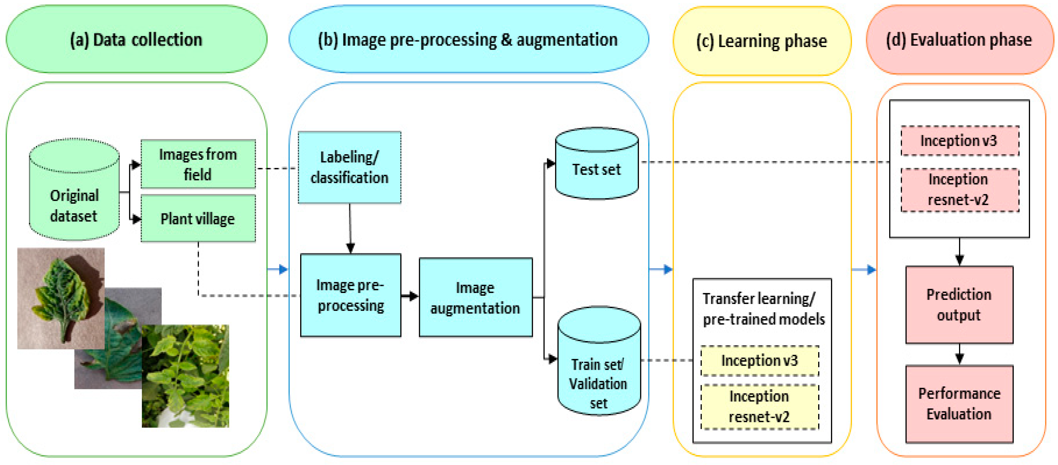
Implementation Details

Slide 7
Software Tools used
Tool / Library | Purpose
Python | Main programming language
TensorFlow / Keras | To build and train the Convolutional Neural Network (CNN)
Streamlit | To build the web-based user interface (web app)
NumPy | For numerical operations
PIL (Pillow) | For image loading and processing
ImageDataGenerator | For image preprocessing and augmentation
7

Slide 8
Feasibility
Low-Cost Development: Open-source tools reduce cost
Maintenance: Minimal—model retraining with new data
User-Friendly Interface: Simple UI for farmers (in local languages)
Fast Diagnosis: Instant feedback from uploaded images

Slide 9
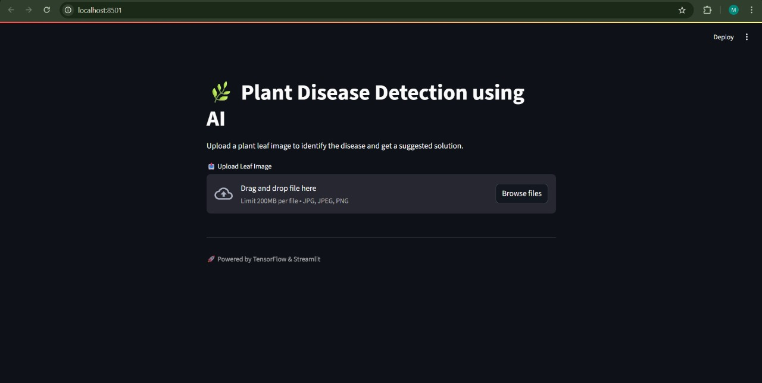
MODULES
.

Slide 10
Reference
Ferentinos (2018) – CNN-based plant disease diagnosis with >99% accuracy on PlantVillage. https://doi.org/10.1016/j.compag.2018.01.009
Mohanty et al. (2016) – Deep learning for image-based detection across 38 plant disease classes. https://doi.org/10.3389/fpls.2016.01419
Too et al. (2019) – Compared fine-tuned CNNs (VGG, ResNet, Inception) for plant disease classification. https://doi.org/10.1016/j.compag.2018.12.005

Slide 11
Thank you!

